Slide 1
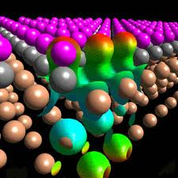
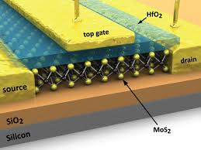
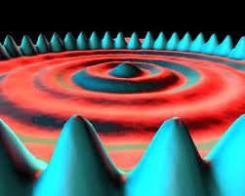
Physics 471: Solid State Physics Professor Micky Holcomb Office Hours: Wednesdays 1:30 – 2:30 How many people have a conflict? I could move. mikel.holcomb@mail.wvu.edu http://community.wvu.edu/~miholcomb/
Today: Introduction to me, you, class structure and topic
Notes:
Lost some time due to lost internet on first day of class (of course). Barely finished pretest.
Notes to self: Dropped periodic table stuff. I generally talk about this later anyway and the Kittel layout doesn’t make sense to start with this topic.

Slide 2
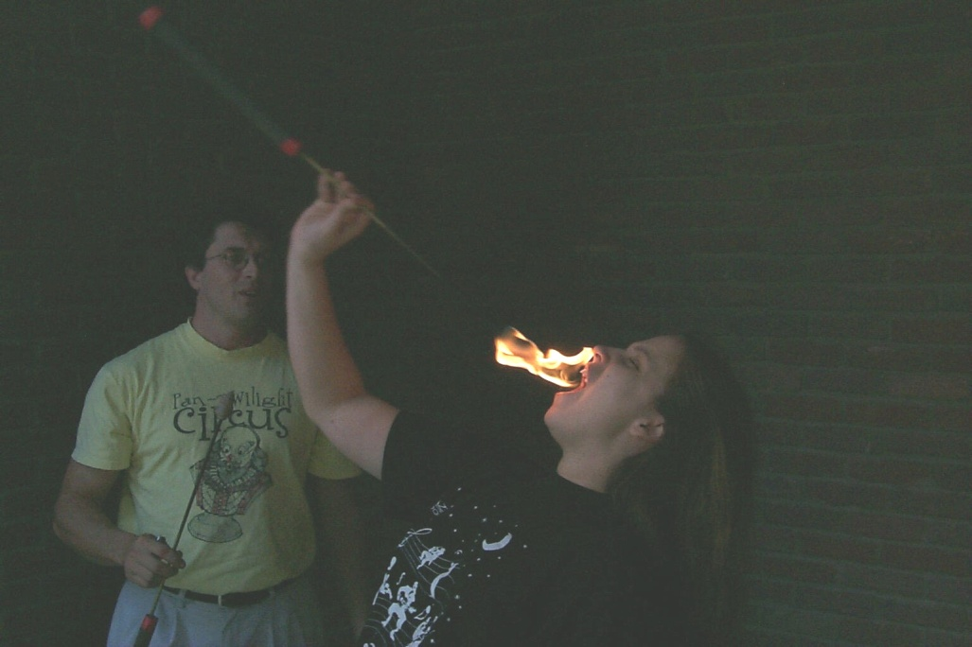
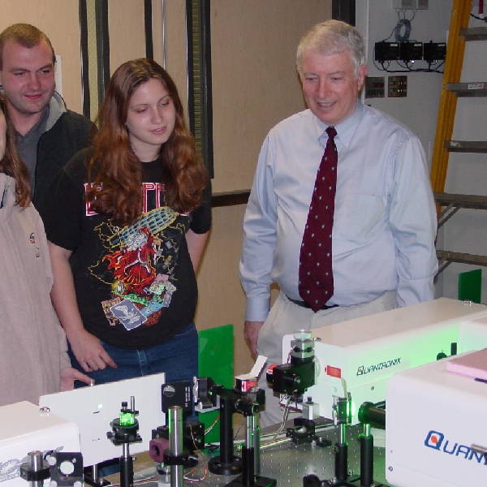
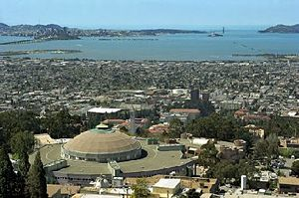
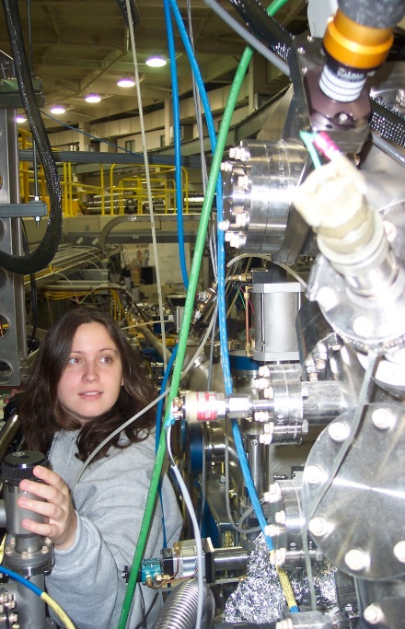
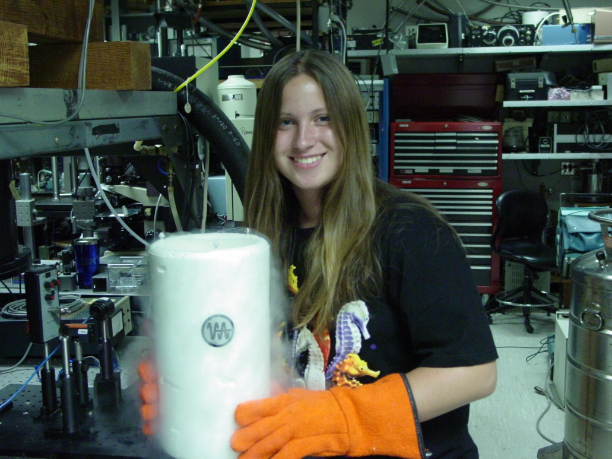
About Your Professor
Went to school at Vanderbilt and Berkeley
Did graduate work at a national lab
Did internship at IBM on quantum computing

Slide 3
About Your Professor
Went to school at Vanderbilt and Berkeley
Did graduate work at a national lab
Did internship at IBM on quantum computing
Toyed with a non-scientific internet startup
Decided I liked research AND teaching

Slide 4
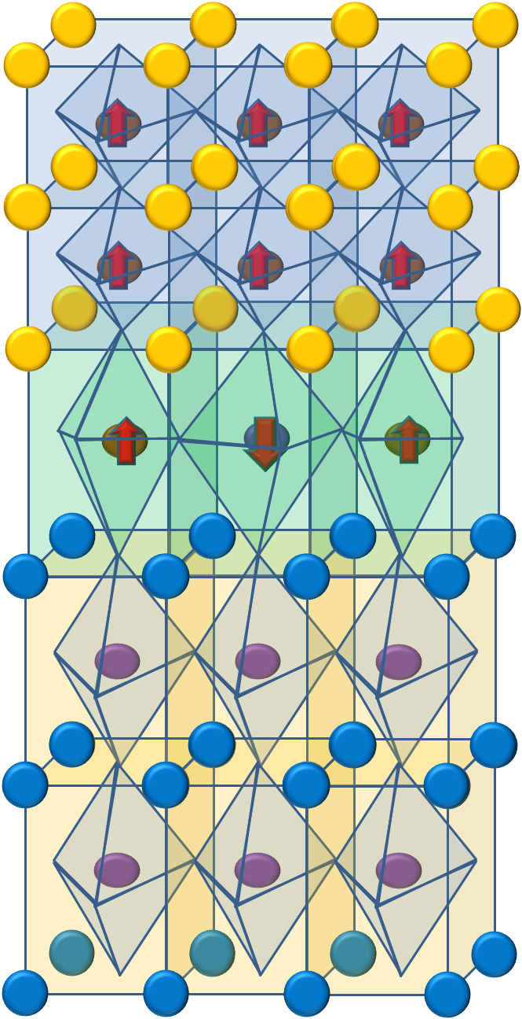
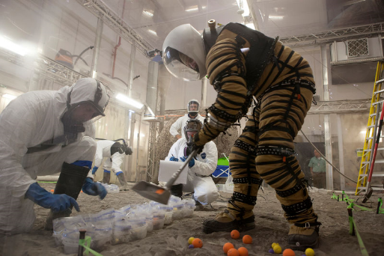
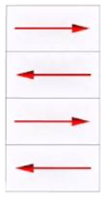
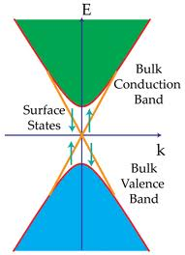
My Work: Surface & Interface Physics
Magnetic Dead Layers
Helping NASA optimize their new single photon detectors
Lot of element specific beamline work
Delafossites ABO₂
Topological Insulators
Perovskites ABO₃ layers
Notes:
3 slide intro to my work
Brief summary of the topics I will not focus on today, but we work on.

Slide 5
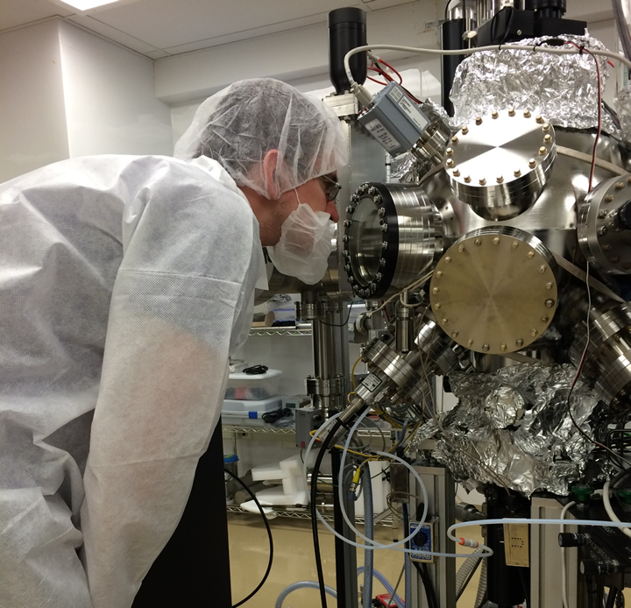
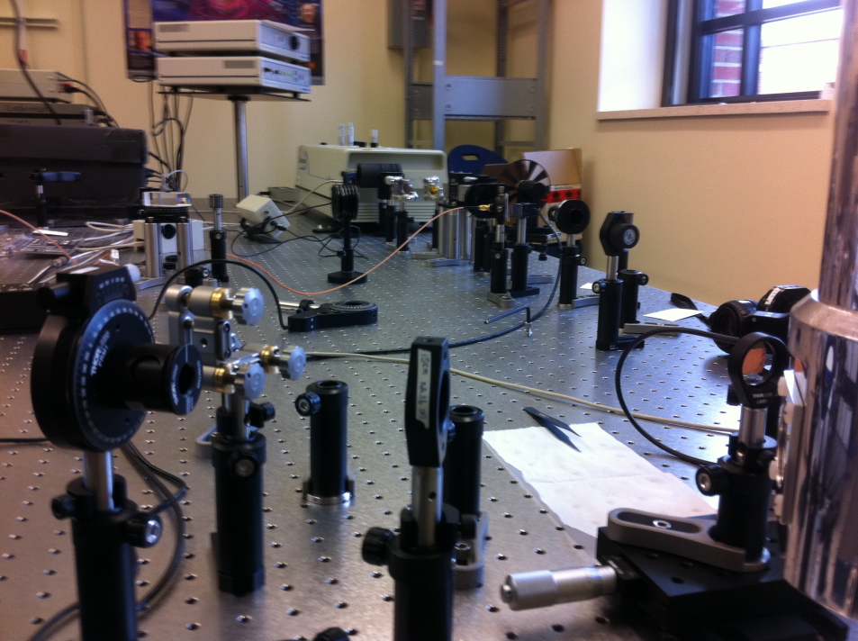
Measurement Techniques
WVU: Growth & Nonlinear Optics
San Francisco
Synchrotron Techniques At National Labs:
X-ray Absorption Spectroscopy
Photoemission Electron Microscopy (PEEM)
Beyond the standard techniques (XRD, VSM, TEM, etc.), we focus on unique interfacial measurement techniques.

Slide 6
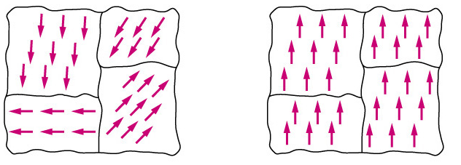
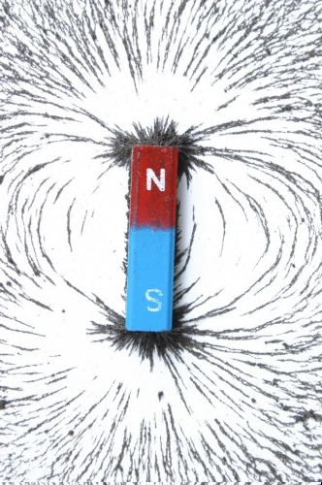
Definitions
Ferromagnetic
Ferroelectric
field
Before field
After field
Spontaneous magnetization whose direction can be changed with an applied magnetic field
Notes:
Ferromagnetism is the form of magnetism with which most people are familiar, as exhibited in bar magnets.
A ferromagnet is defined as… We are probably most familiar with refrigerator magnets
Ferromagnetics are used for the memory in your computer, also in power generation and of course any time you need a permanent magnet, such as on refrigerators and magnets in toys.
Ferroelectrics have a similar effect but with electric polarization or separation of charge. This is easily accomplished in perovskite form by shifting the central atom.
A multiferroic has both of these properties and the potential for coupling between them. Thus, if I applied an electric field, I may be able to change the magnetic properties or vica versa. There are several possible applications, but computing is causing the most interest since computing is becoming less and less energy efficient at a increasing rate as we make computers smaller and faster. This problem is why our cell phones have to be charged so frequently. While battery technology is trying to keep up, a much better route would be energy efficient electronics. You can also imagine that these materials would be useful for energy scavenging, harnessing electrical power from a changing magnetic field. These materials might also be great for portable magnetic sensors.

Slide 7
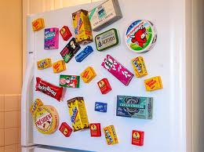
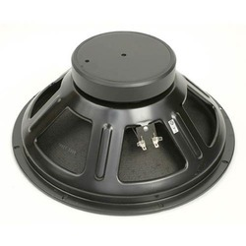
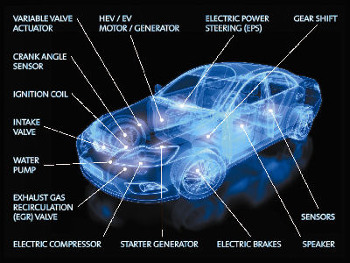
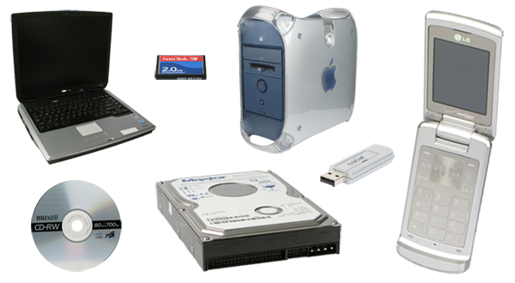
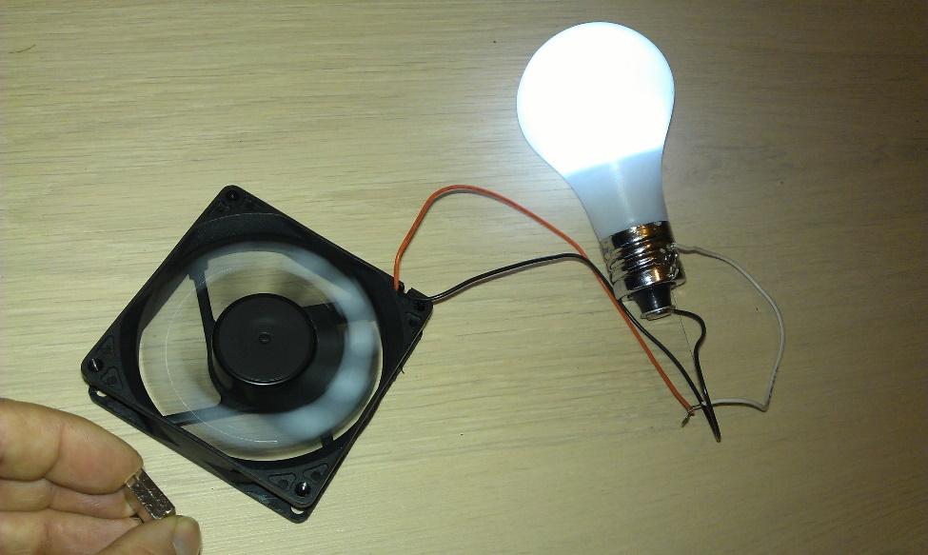
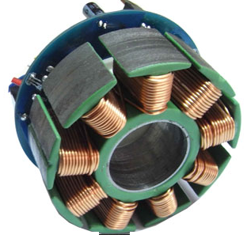
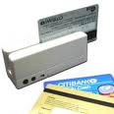
Applications of Magnetism
Sound
Information storage
Various Automotive
Reducing Friction
Health
Energy generation
Why should we care about magnetism?
Notes:
Nice applications figure and article: https://ozank.gitbooks.io/ee361/magnetic_circuits/permanent_magnets.html

Slide 8
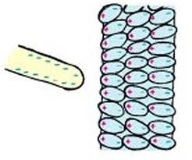
Definitions
Ferromagnetic
Ferroelectric
Spontaneous magnetization whose direction can be changed with an applied magnetic field
Spontaneous polarization whose direction can be changed with an applied electric field (voltage)
Multiferroic
Notes:
Ferromagnetism is the form of magnetism with which most people are familiar, as exhibited in bar magnets.
A ferromagnet is defined as… We are probably most familiar with refrigerator magnets
Ferromagnetics are used for the memory in your computer, also in power generation and of course any time you need a permanent magnet, such as on refrigerators and magnets in toys.
Ferroelectrics have a similar effect but with electric polarization or separation of charge. This is easily accomplished in perovskite form by shifting the central atom.
A multiferroic has both of these properties and the potential for coupling between them. Thus, if I applied an electric field, I may be able to change the magnetic properties or vica versa. There are several possible applications, but computing is causing the most interest since computing is becoming less and less energy efficient at a increasing rate as we make computers smaller and faster. This problem is why our cell phones have to be charged so frequently. While battery technology is trying to keep up, a much better route would be energy efficient electronics. You can also imagine that these materials would be useful for energy scavenging, harnessing electrical power from a changing magnetic field. These materials might also be great for portable magnetic sensors.

Slide 9
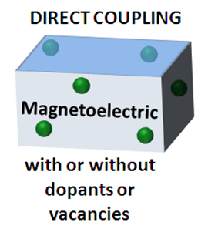
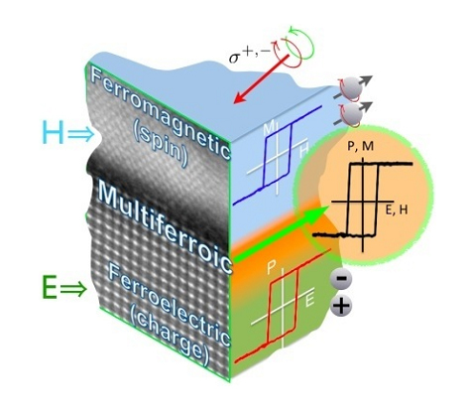
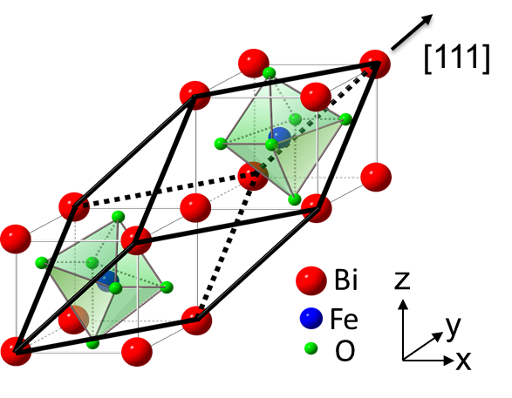
Electric Control of Magnetism
Coupling at interfaces is not well understood
Review paper, Holcomb et al., IJMPB (2012)
http://www.helmholtz-berlin.de/forschung/magma/m-dynamik/forschungsbereiche/multiferroicity_en.html
Notes:
Most of the focus in the field has been so far on single material multiferroics, but this is not the only way to combine ferroelectricity and magnetism. In fact, single phase materials so far have been somewhat limited, since only BFO demonstrates properties at room temperature and the coupling is weak. Here are some approaches to create multiferroic interfaces, instead of single materials.
The problem is that much like exchange bias between a ferromagnet and an antiferromagnet--coupling at interfaces is not well understood.

Slide 10
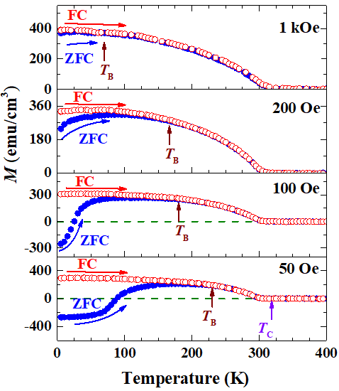
Discovered a New Kind of Magnetism!
= cooled in a field
7.6 nm LSMO on STO
Typical Magnetic Data
= cooled in no field
Negative magnetization at low fields, which is what we would be applying in real world applications.
Aligning opposite the applied field!
Navid Mottaghi, et. al. JPCM 2018
Notes:
Kind of similar to in AFMs: At very low temperatures, the solid exhibits no response to the external field, because the antiparallel ordering of atomic magnets is rigidly maintained.
If there is strong anisotropy it would increase at low temperatures
Another feature found in our M-T curves is that in different fields the difference between the ZFCand FC magnetization values (degree of thermo-magnetic irreversibility) depends on the H. Whilein low fields, TMI is large, it decreases monotonically and disappears in higher fields. Joy et al.16,17have studied the H and HCdependence of TMI on different ferromagnetic and ferrimagnetic systemsand arrived at an empirical relation given in equation 1. The underlying aspect of this relation is thatthe temperature variation of anisotropy field plays a major role in determining the degree of TMI.
all indicating different ordering and/or freezing processes in the system
In the present case, there exists irreversibility in the ZFC and FCW curves even at room temperature, which suggests the presence of inter-particle interactions or some particles in the blocked state
Determination of blocking temperatures: Good, bad and ugly: https://aip.scitation.org/doi/10.1063/1.4935484

Slide 11
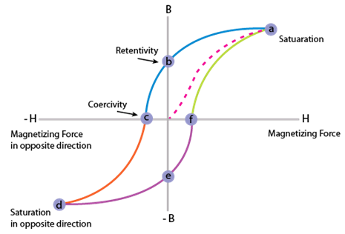
Other Interesting Results
field
Before field
After field
2
1
2
Typical hysteresis loops
3

Slide 12
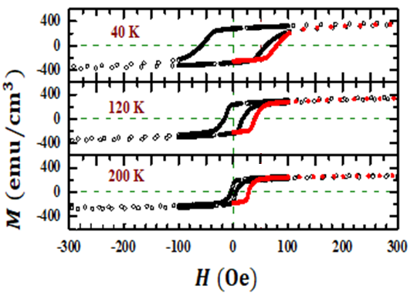
Other Interesting Results
Larger field needed initially.
But not just the first time it sees a field!
2
1
2
Typical hysteresis loops
Navid Mottaghi, et. al. JPCM 2018
3

Slide 13
Inverted Loops at Higher Temps
At temperatures just below the critical temperature, the magnetization actually reverses when you just turn the field down!
Might make a sensitive sensor!
Typical hysteresis loops
near room temperature

Slide 14
As we are about to spend a lot of time together, please introduce yourself.
Name and Year
Department
Planned career path (or possibilities, if debating)
Why are you taking this course?

Slide 15
Important Class Issues
Text: Introduction to Solid State Physics by Kittel (in stock on Amazon, $3 - 99) 8th edition preferred
Recommended: Ashcroft and Mermin’s Solid State Physics, Holgate Others
Lecture PPTs will be available online shortly after class. (additional material often available)
I expect you to do the Kittel reading (and ideally skim another book) before coming to class so that we can focus on details/applications. There is another reason.
Notes:
Pass out syllabus.
Have you ever had a professor that taught straight from the book? What was the point of ever reading?

Slide 16
How Do We Learn?
Why cramming does not work for the long run
Through Repetition: the more times (and more ways) we repeat something, the more important our brains think it is, and the more likely we are to remember it
Another good reason to read multiple books
Notes:
Ask: What does this graph tell us?
Use popular song lyrics as an example of “passive” learning through repetition. Dangers with repetition are boredom and brain overload. By taking a reasonable pace and presenting the same information in multiple ways, this can be avoided.

Slide 17
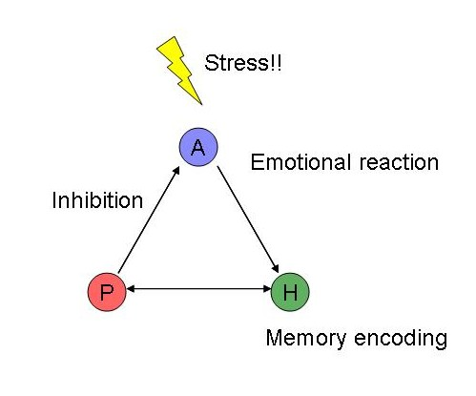
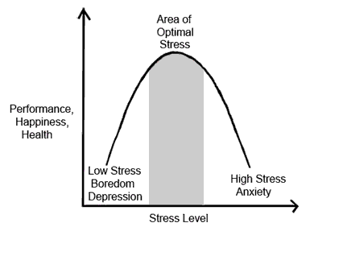
How Do We Learn?
Amygdala:
Fight or Flight
Hippocampus:
Memory
Prefrontal Cortex:
Executive Function
My Goal
Why Cramming Doesn’t Work
Notes:
When amy is overexcited, it will inhibit both hippo and prefrontal. Amy also involved in attentiveness, which can help you focus. Cramming leads to lack of sleep, and sleep helps you remember. (Paul crammed for a test without sleep and then fell asleep during the test and woke up and could not remember it.
Stress curve is a little harder because each student has a different stress curve and the curve can be affected by life events, but as medical issues or even happy things like weddings.

Slide 18
Course Grading
Course Grade: Homework 20%, Tests 1/2 30% each, In-class Discussion 6%, Presentation 10%, Show and Tell Diffraction Day 2%, GroupMe Discussion 2%
Grading scale: A (>85), B (70 - 84), C (60% - 69%), D (50% - 59%), F (<49%)

Slide 19
Discussion Questions
Some of these questions will be relatively easy to make sure you have important background. If everyone thinks it’s easy, we’ll move through these fast. Otherwise, vital to cover.
Some of the questions will be harder. My goal is to coach you through these problems, not just do them for you. You learn more this way.

Slide 20
Encouraging Your Discussion Among Yourselves
I believe getting you students to talk about the material is one of the most important features to help student learning in a course.
We will use GroupMe to discuss class questions. To encourage use, I will be grading your participation (not correctness) in these discussion as 2% of your grade.

Slide 21
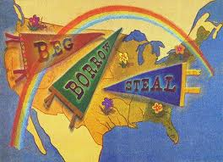
My Teaching Philosophy Regarding Slides
If you become a professor, you will be instructed to (regarding teaching) “beg, borrow and steal.” Preparing a good lecture is hard! So, if someone manages to, then reuse it!
Therefore, many of my slides are adaptations. I pick what I deem to be the most instructive slides and try to improve.
I find this to work out pretty well, accept that there are many different notations for the same things are used. (e.g. lattice vectors)
In reality, papers use different notation, so it is a useful practice to get used to multiple forms of terminology. Please ask if you are confused about any terminology.

Slide 22
Pre-test To best teach you, I need to know what you know and don’t know. I will give you a few points for completeness; correctness is irrelevant (other than for my planning).
Today’s Plan:
Take pre-test/survey. When finished, read over syllabus. If time remains, I will introduce SSP.

